Slide 1
CLOUD COMPUTING

Slide 2
In cloud computing, the capital investment in building and maintaining data centers is replaced by consuming IT resources as an elastic, utility-like service from a cloud “provider".

Slide 3
In the past cloud computing was considered the province of startups and aggressively visionary enterprise users, today, it is part of the enterprise computing mainstream across every industry, for organizations of any type and size.

Slide 4
Characteristics Of CLOUD Computing
Cloud computing has made a profound impact on innovation and the economics of business overall. It gives forward-looking organizations the opportunity to not only improve flexibility, reduce costs, and focus on core competencies, but also to fully transform how they operate.

Slide 5
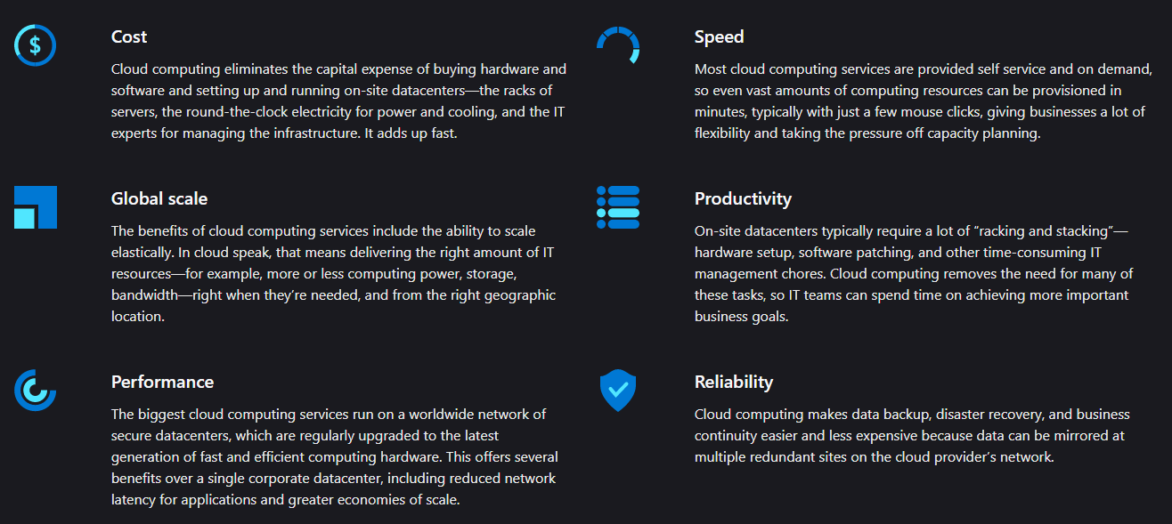
Some Benefits of Cloud Computing include:

Slide 6
Capabilities Of CLOUD Computing
Most cloud computing services fall into four broad categories: infrastructure as a service (IaaS), platform as a service (PaaS), serverless, and software as a service (SaaS).

Slide 7
Cloud Computing can be used to :
Create cloud-native applications
Test and build applications
Store, back up, and recover data
Analyze data
Stream audio and video
Embed intelligence
Deliver software on demand

